Slide 1
Turtle Games Data Analytics Project
Project Aim:
Analysing Customer Sentiments
Exploring Loyalty Points Acquisition for Marketing
Impact of Individual Product Sales
Relationship between Sales Regions
Notes:
Hello everyone! Today I will be presenting my analysis on turtle games. Our aim will be to….

Slide 2
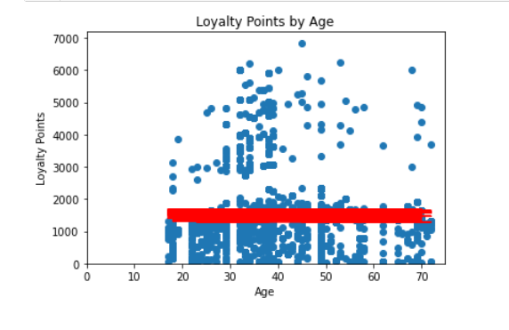
Age Vs Loyalty Points
Loyalty Points
Relationship failed – Flat Red Line
R-squared value – 0.2%
Notes:
To begin with lets check how various variables affect loyalty points acquisition. Lets check how age plays a role in that…. We can see age doesn’t really affects loyalty points acquisition

Slide 3
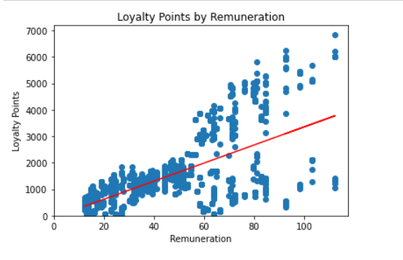
Vs Remuneration
Better than Age
R-squared value – 38%.
Notes:
Remuneration affects loyalty points acquisition more than age. 38% of variations in loyalty points is explained by remuneration

Slide 4
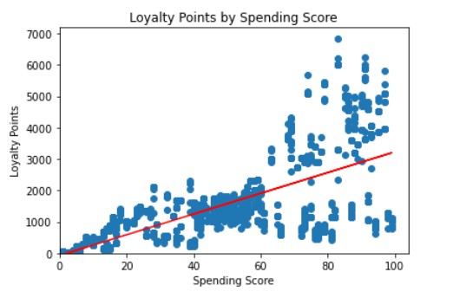
Vs Spending Score
Better than Remuneration.
R-squared value – 45.2%
Notes:
Spending score is even better, it explains 45.2% of variations in loyalty points

Slide 5
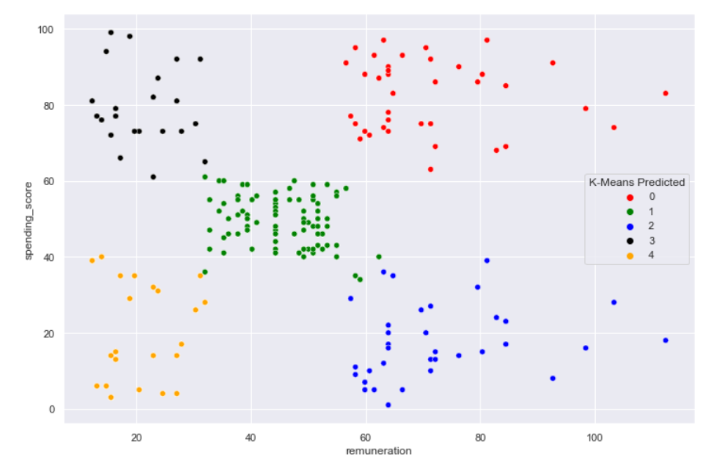
K means Clustering
Remuneration and Spending Score segmented
K=5: Silhouette and Elbow Method
Most evenly distributed clusters.
Notes:
Further exploring into remuneration and spending score, we have segmented the customers in 5 clusters for marketing team to target them by specific campaigns. We finalised 5 clusters based on our results from silhouette and elbow method. We also checked distribution for 4 and 6 clusters but 5 has most evenly distributed clusters

Slide 6

Wordcloud
Customer Sentiments
Summary column wordcloud
NO major Negative words.
Review column similar as well.
Notes:
Looking into customer sentiments, lets first explore results from wordcloud for the most commonly used words in customer feedback. They are generally all positive.

Slide 7
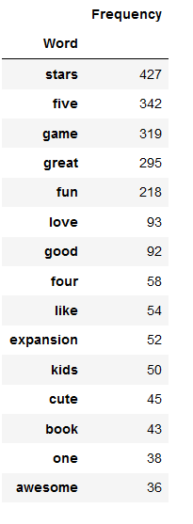
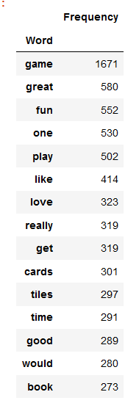

Frequent 15 Words
Nothing Negative highlights
Context not sure for some.
Notes:
We can even dive into the exact top 15 most used words. Table on left belongs to summary and right one belongs to reviews

Slide 8
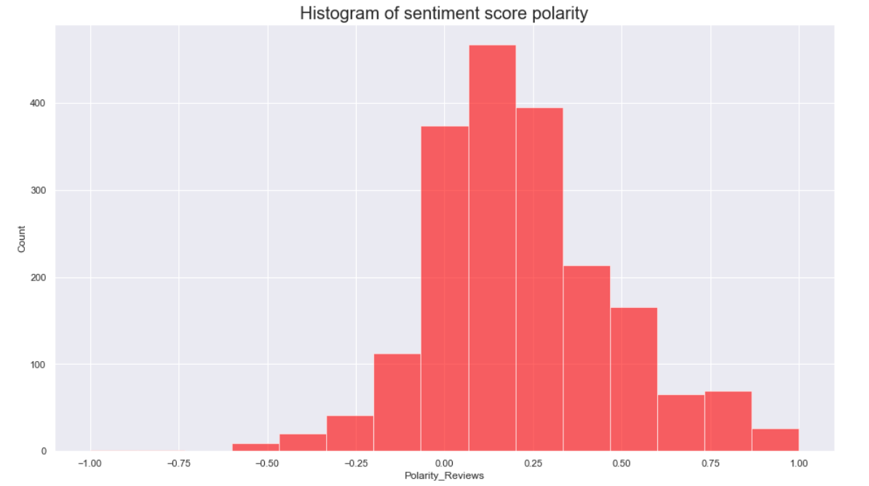
Polarity and Sentiment Score
Review Column Results
Concentrated at Neutral
More Positive than Negative
Notes:
Exploring further we can see that there are more positive comments than negative for review column although majority is concentrated at neutral

Slide 9
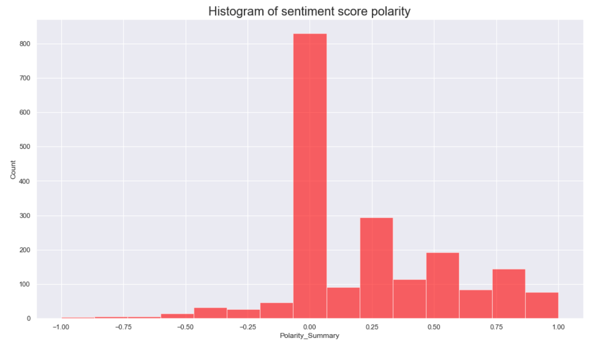
Polarity and Sentiment Score
Summary Column Results
Concentrated at Neutral
More Positive than Negative
Notes:
We can see similar results for summary column as well

Slide 10
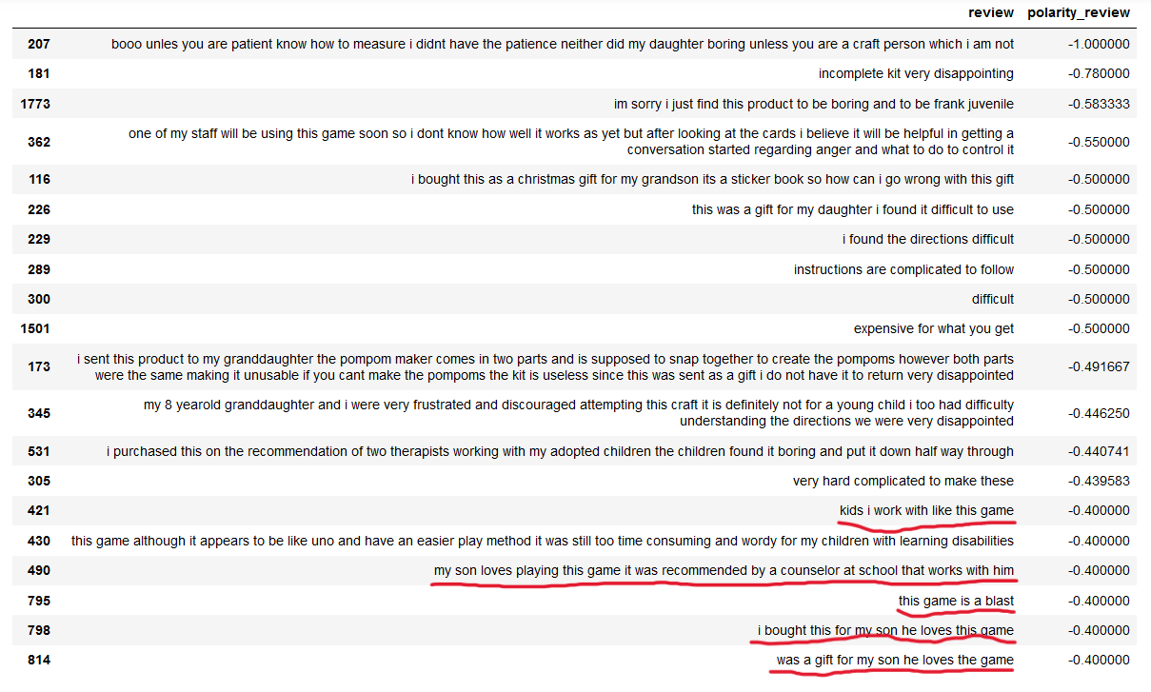
Top 20 –ve and +ve Comments
Results based on Polarity Score
Very few very bad
More of very good
Certain misinterpretations
Notes:
Looking into top and bottom 20 comments by polarity score, we found certain misinterpretations by our model. Bottom five on the chart all sound positive but are given negative polarity score

Slide 11
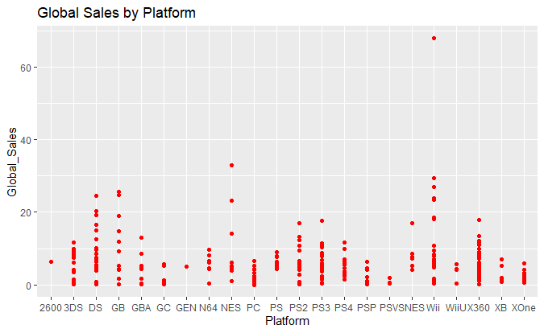
Sales by Platform
Product Sales
Top Turnover game on Wii same result for NA and EU
5 of Top 10 on Wii
7 of Bottom 10 on PC
Notes:
Analysing sales data- we can easily conclude that top turnover game was sold on wii platform globally. Infact 5 of top 10 sell on wii platform and 7 of bottom 10 on PC

Slide 12
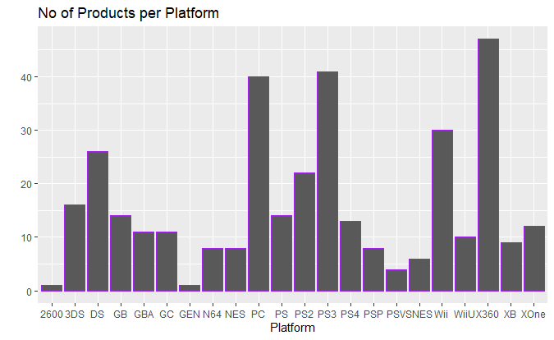
Products per Platform
Most games sold on x360
Followed by PS3 and PC
One game each on 2600 and Gen
Notes:
Exploring our data further we observed that we sale maximum number of products on x360 followed by ps3 and pc. We sell only one game each on 2600 and gen

Slide 13
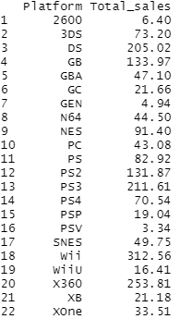
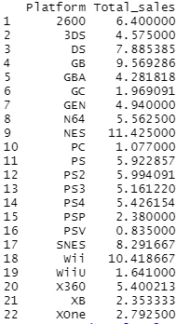
Mean and Sum per Platform
Highest Mean – NES, Lowest - PC
Highest Sum – Wii, Lowest - PSV
Notes:
Moving on we establish performance of each platform. Top sales generator is wii and lowest is psv. Looking at average sales per game on each platform - NES tops while pc is at the bottom

Slide 14
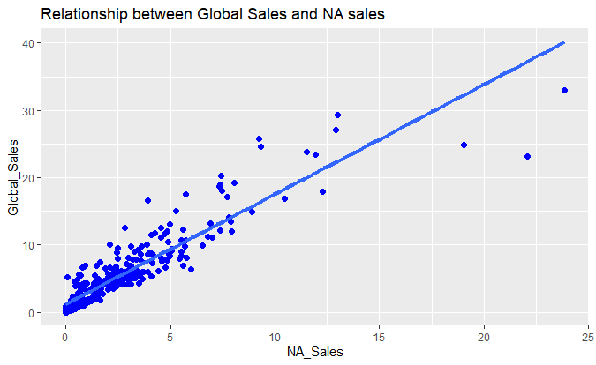
Global Vs NA
Sales Region Relation
Strong Correlation
Similar results for Global Vs EU
Statistical Values suggest data is positively skewed
Notes:
Lets move on to exploring relationship between our regions and if we can use them to predict global sales. There is a strong correlation between NA sales and global sales. Analysis showed similar results for EU sales as well.

Slide 15
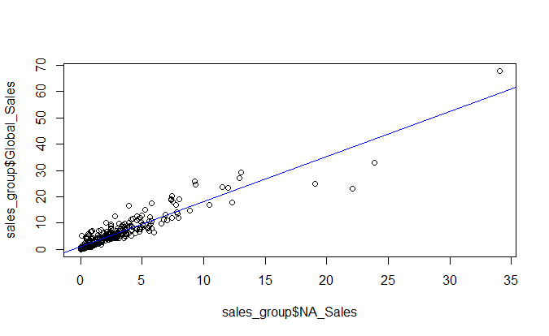
Predicting Global using NA and EU
NA sales significant value for Global Sales
Explains over 87% variability in Global Sales
EU explains 77% variability
Notes:
In terms of prediction capabilities- NA sales is a significant value for global sales, it explains over 87% of variability in global sales while EU explains 77% of variability

Slide 16
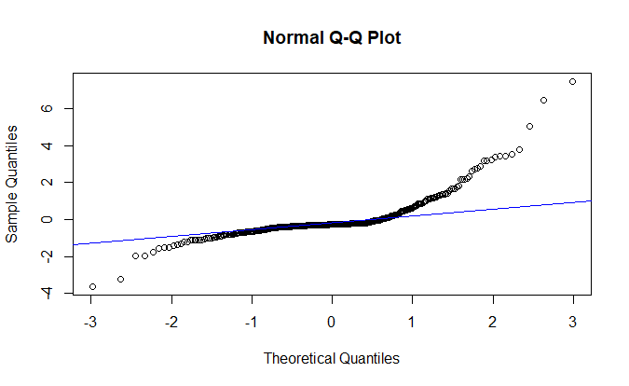
Prediction Model
NA and EU sales combined explain 96.85% variability in Global Sales
Model can be used to predict Global Sales
Notes:
In our model we derived that NA and EU sales combined explain 96.85% of variability in global sales. Which is quite high and test values yielded quite close figures.

Slide 17
Observations
Data Concerns
When were the customer sentiments captured?
Explore more variables to analyse Loyalty Points
Number of games sold for each product?
Selling price per product.
Why sales in regions other than NA and EU negligible?
Does sales data include all products? Customer feedback suggests differently.
What time period is the sales data for?

Slide 18
Conclusion
More Data required to make confident predictions
NA and EU sales data can be used to predict Global Sales
Customer Sentiment generally positive
Loyalty points- other variables need to be explored

Slide 19
QUESTIONS??

